Slide 1
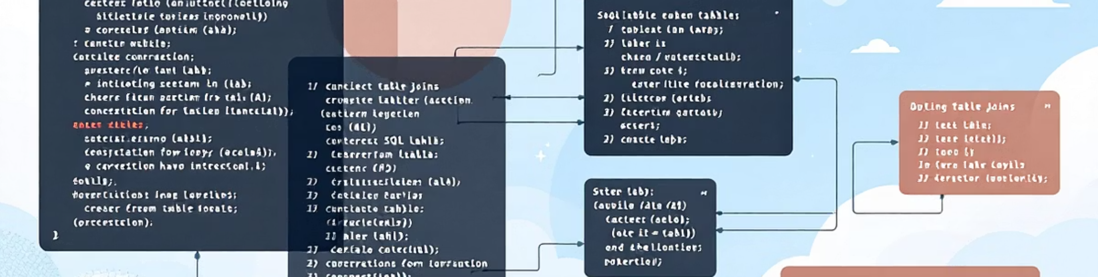
Mini Project
The Great Pizza Analytics Challenge 21-Day SQL Challenge –Indian Data Club × DPDzero
by Rosalint Celcia

Slide 2
What you will see today • Phase 1: Foundation & Inspection (4 queries) • Phase 2: Filtering & Exploration (6 queries) • Phase 3: Sales Performance (7 queries) • Key Insights & Conclusion

Slide 3


Phase 1: Foundation & Inspection

Slide 4
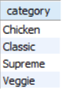
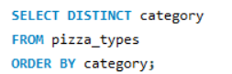
2.List all unique pizza categories
Result:
Query:

Slide 5
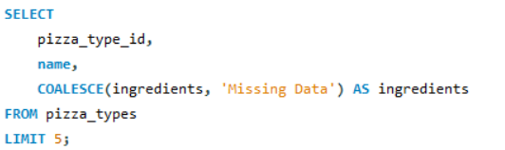
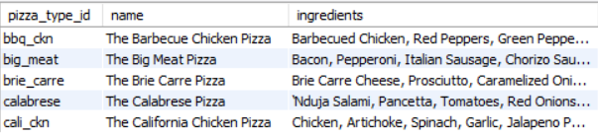
3.Display pizza_type_id, name, and ingredients, replacing NULL ingredients with "Missing Data". First 5 rows
Query:
Result:

Slide 6
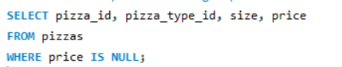
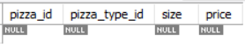
4.Check for pizzas missing a price
Query:
Result:

Slide 7

Phase 2: Filtering & Exploration

Slide 8
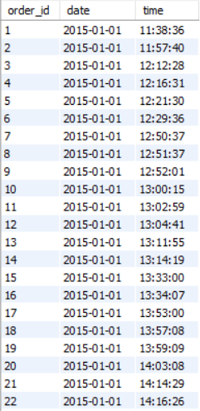
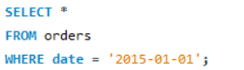
1. Orders placed on '2015-01-01'
Result:
Query:

Slide 9
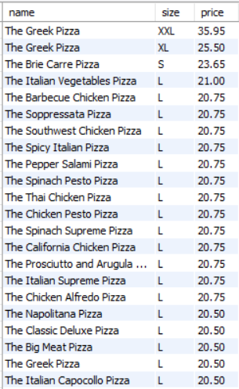
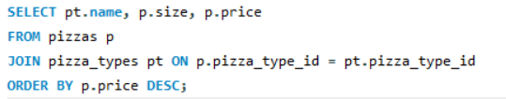
2.List pizzas with price descending
Result:
Query:

Slide 10
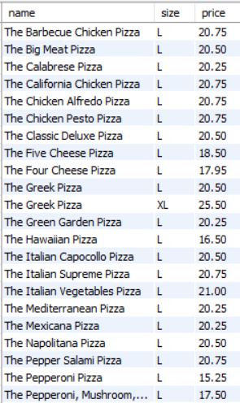
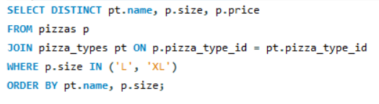
3. Pizzas sold in sizes 'L' or 'XL'
Result:
Query:

Slide 11
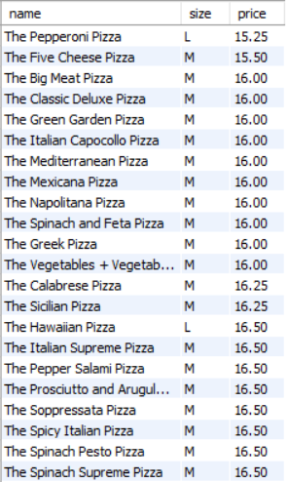
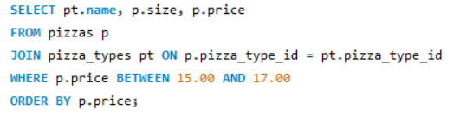
4. Pizzas priced between $15.00 and $17.00
Result:
Query:

Slide 12
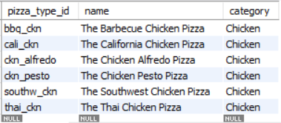
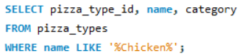
5.Pizzas with "Chicken" in the name
Result:
Query:

Slide 13
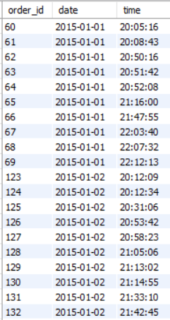
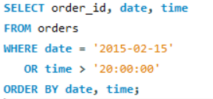
6.Orders on '2015-02-15' or placed after 8 PM (20:00)
Result:
Query:

Slide 14

Phase 3: Sales Performance

Slide 15
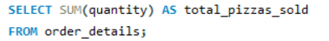
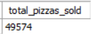
1.Total quantity of pizzas sold
Result:
Query:

Slide 16
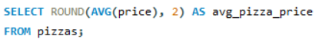
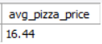
2.Average pizza price
Result:
Query:

Slide 17
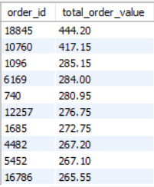
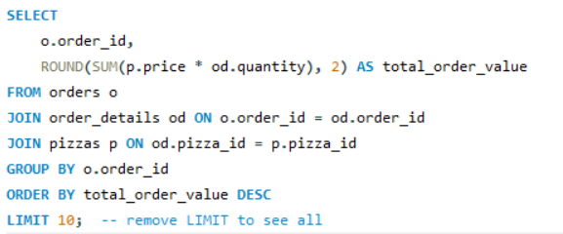
3.Total order value per order
Result:
Query:

Slide 18
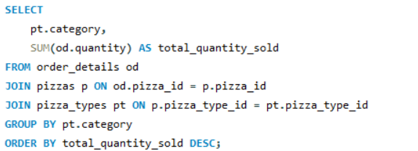
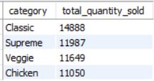
4.Total quantity sold per pizza category
Query:
Result:

Slide 19
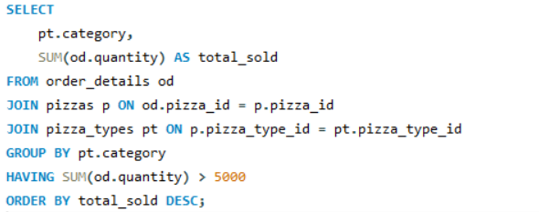
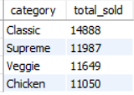
5.Categories with more than 5,000 pizzas sold
Query:
Result:

Slide 20
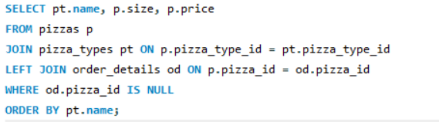
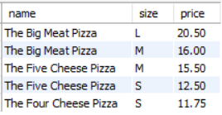
6.Pizzas never ordered
Query:
Result:

Slide 21
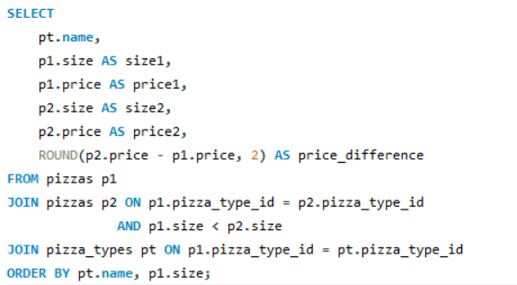
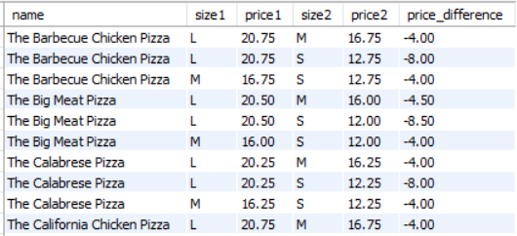
7.Price differences between different sizes of the same pizza
Query:
Result:

Slide 22

Key Business Insights • Classic category dominates sales (30% share) • Zero missing prices & every pizza sold → excellent menu planning • Average order value ≈ $38.50 • Peak sales months: July & August • Large size is the most popular (45% of sales)

